Slide 1
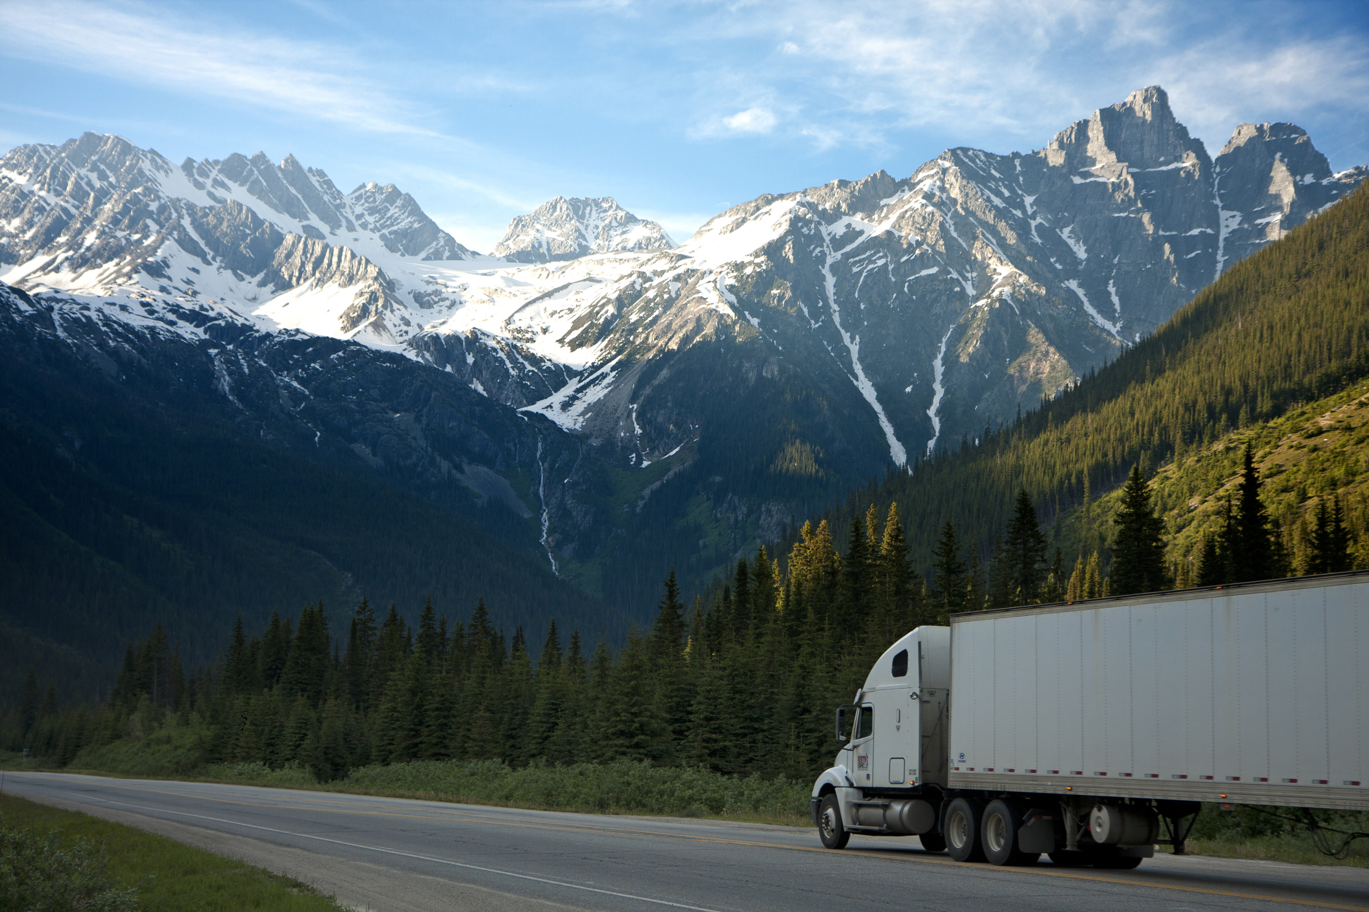
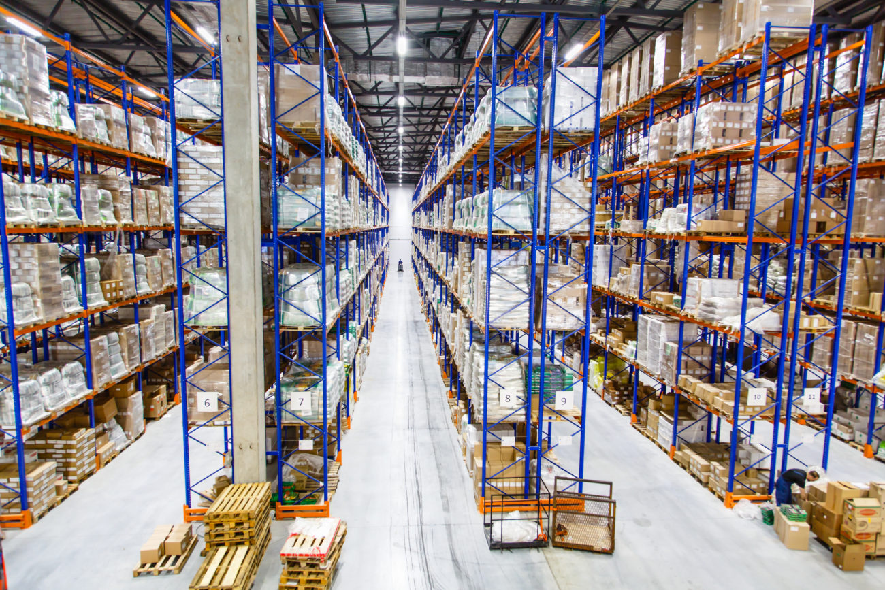
Inventory Control System
Takealot Ecommerce Simulation System
Jocelyn Atwell: 201800014
Project Coordinator: Dr Ibidun Obagbuwa
Notes:
Good Morning Ma'am and classmates
Today I will be talking about the inventory control system but more specifically about the Takealot Inventory System

Slide 2
Outline
01
02
03
INTRODUCTION TO THE PROJECT
ETHICAL/LEGAL CONSIDERATION
RESULTS
Conclusions and Recommendations
Preview of Related Literature(Briefly)
Methodology
04
REFERENCES
Questions
Notes:
The following slide shows the outline of what will be discussed during this presentation, namely the....

Slide 3



Inventory Control System
What is the importance
of using
Inventory Systems?
What is an Inventory Problem?
Types of Inventory Problems
Notes:
What is an inventory system?
* An inventory system can be described as a system that encompasses all the aspects of a companies inventory management which includes purchases, receiving, shipping, warehousing, tracking, turnover or profits, reordering as well as storage.
What is the importance of using an inventory system?
* The importance of an inventory system is to ensure that all the associated activities of a companies inventory management are performed within the correct sequence to have an effective and efficient inventory control system. Computerised inventory simulations such as the matlab simulation allows the company to integrate various functioning subsystems that operate under one single system.
Types of inventory problems
*There are three types of inventory systems, namely: the periodic inventory system, the perpetual inventory system as well as the manual inventory.
The manual inventory relies heavily on manual record keeping methods and are mainly used for small business that require no special tools but this is very time consuming.
The perpetual inventory system focuses on real time data and processing of it. Many special tools are required for use such as RFID tags or scanners which are automatically linked to a spreadsheet system or database for data collection and storage. It is very fast and effective and leaves little to no room for human error, however the equipment required for this system are expensive to purchase and maintain.
Finally the periodic inventory system makes use of the physical counting of data on a periodic basis which could be weekly, monthly, quarterly or yearly. This system also makes use of scanners and RFID tags to scan, collect and store data fast and effectively, however it is time consuming as it is not done in real time and on a daily basis as the bulk of the data collection and storage would have to be done for a longer time per period session.

Slide 4

TAKEALOT INVENTORY PROBLEM
PROBLEM/ RESEARCH QUESTIONS
TAKEALOT INTRODUCTION
SOLUTION APPROACH
Notes:
Takealot Introduction:
* Takealot is an ecommerce retailer in South Africa. This business has over 21 departments to select from when searching for an item to purchase online. These departments include Lifestyle, Media and Gaming, Fashion as well as Electronics.
Takealot has their own logistics company as well which eliminates the middleman and allows them to deliver their products safely and directly to the customer. There are three strategically placed warehouses in South Africa, namely in Cape Town, Durban and Johannesburg.
For inventory purposes only I have excluded the Durban and Johannesburg warehouses from this experiment and included a Pretoria warehouse as well as a Bloemfontein warehouse. The reason for this is to have a warehouse located on both lateral sides of the country as well as a central based warehouse.
Having warehouses that are not too far from the customers delivery address ensures that a customer does not wait too long for their parcel to be delivered if they would be ordering items from the nearest warehouse.
Problem Description:
*Takealot is an ecommerce retailer that sell items from various departments and deliver their products directly to their customers. They would like to know, when a customer adds items to their online shopping cart, considering the VAT, shipping costs, etc; what would the grand total of an online order placed be? Secondly, how long would it take for the package to be delivered? Would they make a profit or a loss per order?
Solution Approach:
*Data would be collected from the customer that would be able to answer all three research questions. These results would be separated into three parts, namely: the order details which include the grand total results, the estimated time for each delivery per order placed as well as the profits made per customer order. These results would be simulated and represented in graphical format with visual representations.

Slide 5
1
2
ASSUMPTION 1
ASSUMPTION 2
Main warehouses are less than 12 hours away from each customers location in South Africa
Shipping costs differ when certain conditions are met
ASSUMPTIONS
3
ASSUMPTION 3
4
ASSUMPTION 4
Discount coupons reduce the final payment
All three warehouses have full stock available
Notes:
Assumption 1:
*There are three main warehouses only, in Cape Town, Pretoria and Bloemfontein. The Bloemfontein and Pretoria warehouses were replaced by the Durban and Johannesburg warehouses for hypothetical purposes. By spacing out the warehouses within the geographical locations of the country, each city in every province would have a nearest warehouse to them with the estimated time it would take to travel between the two points less than 12 hours or 720 minutes. This allows the logistics department to deliver their parcels within the same day the parcels were packaged and cleared for delivery or it would be delivered the following day.
Assumption 2:
*The second assumption is that shipping costs differ depending on whether the customer lives in the same city, the same province or a different province and whether or not they would be collecting their parcel on site or not. Another factor that contributes to the shipping cost is that if any order place has a cumulative total price greater than or equal to R500.00, shipping costs would be free of charge.
Assumption 3:
*Discount coupons reduces the grand total or the final payment price of the customer payment by a certain percentage, however if no coupon is presented, the default value would be 1. By having a default value of 1, when it is multiplied by the rest of function 6, it would not have any significant effect on the final grand total payment amount.
Assumption 4:
*The fourth assumption is that all three warehouses have the items added to the cart in stock. If the warehouse does not have that particular item in stock, the customer would be notified that the items are out of stock and would be referred to a related product to consider purchasing. If the allocated Bloemfontein warehouse does not have a particular item in stock they are unable to refer the customer to another warehouse.

Slide 6
5
6
ASSUMPTION 5
ASSUMPTION 6
Google GPS Maps used to estimate distances
2-3 days to package orders prior to delivery.
ASSUMPTIONS
7
ASSUMPTION 7
8
ASSUMPTION 8
The weight of the parcels are not considered
Parcels expected to arrive at customers location after 2 days
Notes:
Assumption 5:
*The Google GPS map was used to determine the time taken to travel by vehicle from a particular source point which is the allocated warehouse to the destination which is the customers location. A manual search was done to obtain these results.
Assumption 6:
*Once an order is placed and paid for online, it takes 2 to 3 working days to package, seal and clear and order to the delivered from the warehouse to the customers location. In reality, there would be depot point at which the parcels would be delivered before it reached the customer, especially if the customer lives in a different province.
Assumption 7:
*The weight of the parcels were not considered in this experiment and do not contribute any meaningful values to the results as well.
Assumption 8:
*Businesses operate for approximately 9 hours from 08:00 am to 17:00pm. Items packaged and cleared for delivery that takes an estimated 12 or more hours to arrive at the customers destination should be moved to two days thereafter. This assumption only applies if there is only one or two of the three warehouses in operation, but especially if only one of the warehouses are in operation only.

Slide 7

Newspaper Inventory Problem
Problem:
*Bundles bought: 33 cents a paper
*Bundles sold 50 cents per paper.
*Leftover paper sold 5 cents each.
*Paper sold on three types of days: good, fair and poor.
Solution:
*Determines the optimal number of paper to purchase on a type of day and profits of sales
*simulation the results for 10 days
ItsNowOrNever (2016) System Modeling and Simultion: Newspaper Seller’s Problem. India: Youtube.com. Available at: https://www.youtube.com/watch?v=OH8MRT8eqRI.
Notes:
The article of study that helped me understand how inventory systems work would be the newspaper sellers problem.
Within this problem, The newspaper company would buy newspapers in bundles of ten for 33 cents per paper and would sell them for 50 cents per paper. All the scrap paper or leftovers would be sold for the salvage value of 5 cents each.
There were three types of days which affected the sales of the newspapers per day. The three types of days were good, fair, and poor which each had a probability of 0.35, 0.45 and 0.20 respectively. It was also mentioned that the distribution of the papers demanded of each of these days were 2.15.
The problem statement comprised of determining the optimal number of papers the newspaper seller should purchase on a particular day. The solution approach was to simulate the demands for 10 days and record the profits from the sales of each day.

Slide 8
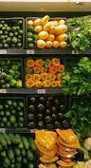
Preservation Inventory Control System
Problem:
*issue of product preservation to measure non-instantaneous deterioration of products.
*swarm optimisation QPSO algorithm used
*demand of product dependent on selling price of product
*high profit produced are indirectly proportional to the cost preservation.
Solution:
*sell products as early as possible - reducing cost of preservation and increasing profits
SubhashChandra Das, A. M. Z. (2020) ‘An application of preservation technology in inventory control system with price dependent demand and partial backlogging’, Alexandria Engineering Journal. Available at: https://www.sciencedirect.com/science/article/pii/S1110016820301058.
Notes:
The inventory control system addresses the issue of product preservation. The system is used to measure the non-instantaneous deterioration of products through using preservation technology.
A swarm optimisation QPSO algorithm is used to overcome the non-linearity of the optimisation problem.
It is found that the demand of the product is dependent on the selling price of the product. It is also found that the profit is independently proportional to the cost of preservation.
The solution found is that retailers should sell their products as early as possible to reduce the cost of preservation and increase their profits.

Slide 9
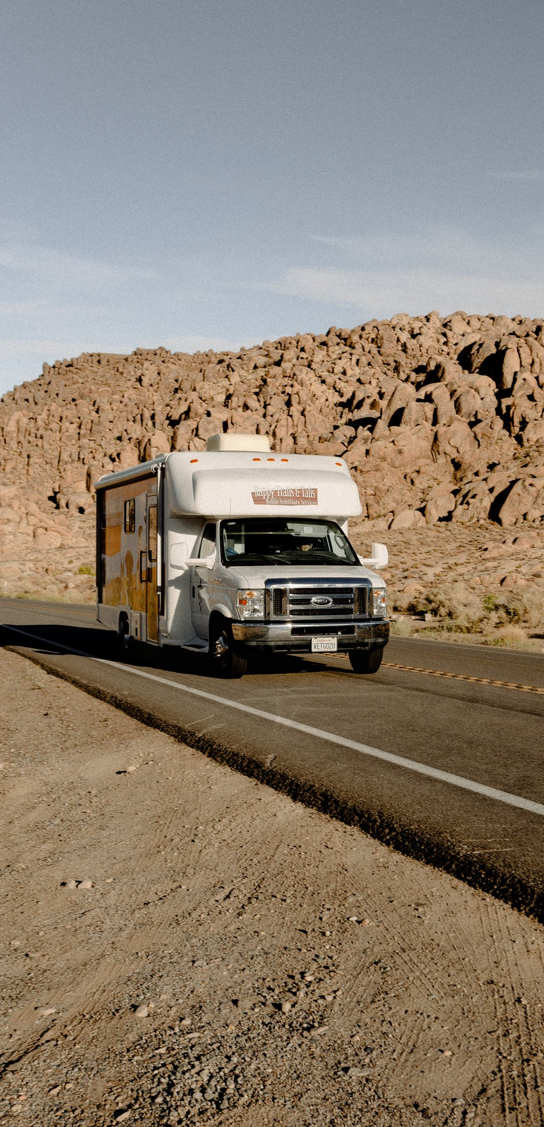
Discrete Event Inventory System
Problem:
*only products in stock are sold.
Solution:
*customer orders products that are handled and delivered
*costs are calculated as well as handling cost
Grogan, P. (2016) Inventory System Discrete Event Simulation in Python (Event-scheduling). Youtube.com. Available at: https://www.youtube.com/watch?v=7LuN_6m7h2o&t=4s.
Notes:
Within this model problem description selling products in stock is only allowed. The stock products would sell for r = 100 each.
The customer interarrival time is calculated. The customers demands follow a uniform distribution.
The costs of the order placed are calculated as well. The delay in the delivery takes between 1 to 2 days. It includes an additional holding cost if condition is met.
Customers would order a product that is in stock which would be handled and delivered to the customer within 1 to 2 days.

Slide 10

Vendor Management Inventory System
Problem:
*manage goods within retail business
*Vendor management inventory method provides sales data and goods for supplier
*system calculates safety stock and reorder stock
Solution:
*results should be availability of goods at 70% and accumulation of goods at 30%
Sabila, A. D., Mustafid, M. and Suryono, S. (2018) ‘Inventory Control System by Using Vendor Managed Inventory (VMI)’, E3S Web of Conferences, 31, pp. 4–7. doi: 10.1051/e3sconf/20183111015.
Notes:
Inventory models objective is to manage goods within a retail business using the vendor managed inventory method.
It provides information like the sales data and goods for the supplier. This is used to calculate the safety stock and reorder stock of goods.
The favoured results should be that the availability of goods should be 70% and the accumulation of goods should be 30%.

Slide 11

Ethical and Legal Consideration
Takealot Website
Notes:
Consideration 1:
Using the robots.txt extension at the end of the ecommerce retailer website, I wanted to clarify if I had permission to scrape the website to get the exact prices for their products within each department as well as their sales and much more. Unfortunately, I was not granted access to do so. For this experiment, all the prices for the items bought online were not the actual prices available on the website, but rather a rough estimate of it.

Slide 12

Ethical and Legal Consideration
Google Maps Website Application
Notes:
Consideration 2:
I was also unable to use the robots.txt extension to clarify if I could scrape the google maps GPS website to extract the estimates between each warehouse and the customers location. The estimates mentioned within the dataset were manually searched for and noted.

Slide 13
Data Creation and Collection
PYTHON PANDAS
PYTHON NUMPY
Library for data frame creation
Pandas
Library for calculations
NumPy
20 ENTRIES PER DAY FOR 3 DAYS
Data Size
60 entries
Notes:
To collect my data I used Python. Since I was unable to use realistic data I had to manually create my own. To do this I used Pandas and NumPy.
Pandas was used to create my data frame or table in which I was able to add all my necessary columns and row elements.
NumPy was used to implement mathematical functions to determine the results for some of the columns which were dependent on the results of another column such as the shipping costs being dependent on the whether or not a customer lives in the same city, same province or different province to mention a few.
The data collected within the table consists of 20 entries of 10 males and 10 females per day for three days. The total number of entries in the data are 60 entries.
For the first days data I used python code to generate the data. For the second and third days data I used excel functions out of convenience.
I could share my code for this after the presentation.

Slide 14
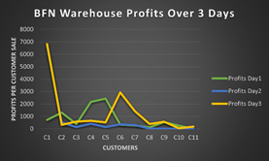
Excel Graphs
Bloemfontein Warehouse Profits for 3 Days
BLOEMFONTEIN PROFITS RESULTS FOR THREE DAYS
Day 3 received more profits than Day 2 or Day 1, because most customers who purchased from the warehouse were allocated to it due to their location.
Notes:
The above graph displays the profits made over the course of three days by the Bloemfontein Warehouse. The profits generated below 1000 rand were from the customers who have placed an order for one or two fairly affordable items. Visually it is clear to see that on Day 3 more profits were made than compared to Day 2 or Day 1. This could also be the case as Day 3 had the most purchases from the Bloemfontein Warehouse due to customers close by being allocated to that specific warehouse

Slide 15
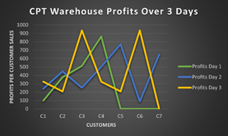
Excel Graphs
Cape Town Warehouse Profits for 3 Days
CAPE TOWN PROFITS RESULTS FOR THREE DAYS
Day 3 made more profits as seen by the two spikes in profit increases.
Notes:
The above graph displays the profits made over the course of three days by the Cape Town Warehouse. Visually Day 3 was when the most profits were generated as seen by the two spikes in the profit increases. The plots where the line graph intercepts with the zero line are when no sales were made then so no profits were generated. We can also say that Day 1 had three sales lesser than Day 2 and Day 3.

Slide 16
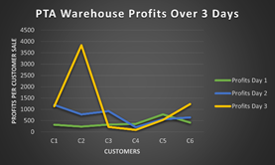
Excel Graphs
Pretoria Warehouse Profits for 3 Days
PRETORIA PROFITS RESULTS FOR THREE DAYS
There were more profits generated on Day 3. The least profits were generated on Day 1
Notes:
The above graph displays all the profits for the first three days of the Pretoria Warehouse. The visuals indicate that there was a spike in profits on Day 3. The least profits generated were on Day 1. The most profits that were generated on Day 3 were a profit of approximately R4 000 for the specific purchase of a particular customer.

Slide 17

MATLAB Simulation
INVENTORY CONTROL SIMULATION
Notes:
The next section of this presentation will be dealing with the MATLAB simulations.
I have to make a disclaimer before I continue and mention that there were a few complications in running the simulation.
However, The successful run of the simulation will be listed under the list of future improvements.

Slide 18
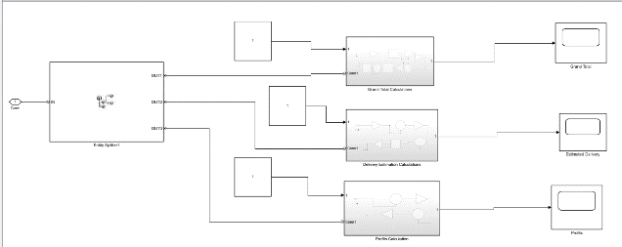
Simulation Model
Complete Takealot Inventory Simulation Model
SIMULATION INVENTORY SYSTEM
The simulation has three subsystems each with a specific task: Grand Total calculation, Distance Estimation and Profits Calculated.
Notes:
The code “Simulink.sdi.view” was used to import all the columns from the python tables as vectors to be able to implement them within the simulation.
The above simulation has three subsystems that each have specific tasks to complete.
Initially, the simulation is suppose to calculate the grand total payment the customer should pay when buying items online and this output should be displayed for the customers to see.
Secondly, the simulation should use the shortest estimated distance between the allocated warehouse and the customers location and display it for the customers to see as their estimated time of delivery which is two days after the items are packaged, sealed and cleared to be delivered.
The final part of the simulation should calculate the profits each warehouse would make per customer sale for each day.

Slide 19
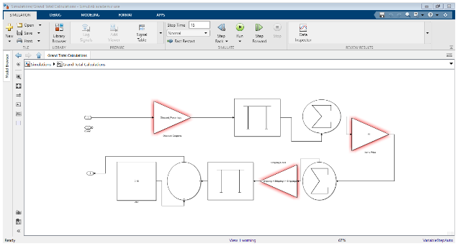
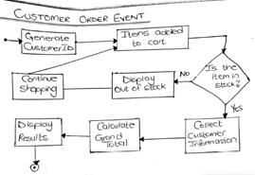
Simulation Model
Subsystems of the Takealot Inventory Simulation Model
GRAND TOTAL EVENT ALGORITHM
GRAND TOTAL CALCULATION GRAND TOTAL SUBSYSTEM SYSTEM
It provides the customer with the final payment total to make a payment.
Notes:
The simulation consists of three subsystems. The first subsystem which is the customer event system, aims to provide the customer with the information they need to do their online payment and ensure that they are paying for the items they have added to their cart. This subsystem simulation would be used by the web development department of the company.
I was not able to obtain these values through the simulation, however I was able to obtain the grand total values through excel formulations.

Slide 20
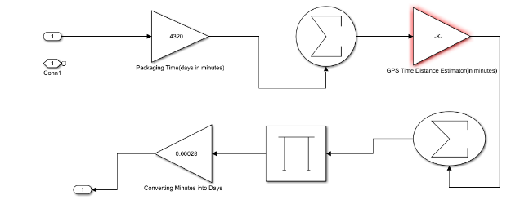
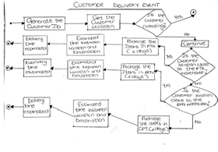
Simulation Model
Subsystems of the Takealot Inventory Simulation Model
DELIVERY EVENT ALGORITHM
DELIVERY ESTIMATION CALCULATION SYSTEM
This subsystem calculates how long it would take to reach the destination
Notes:
The second subsystem is the delivery event system. This would be used by the logistics department of the company. The subsystem aims to provide the mobile logistics technician with the information they need to determine where the parcel should be delivered and how long it would take to reach that destination.
I was not able to obtain these values through the simulation, however I was able to obtain the the minimum distance estimated between the customers location and the warehouse using excel functions as well.

Slide 21
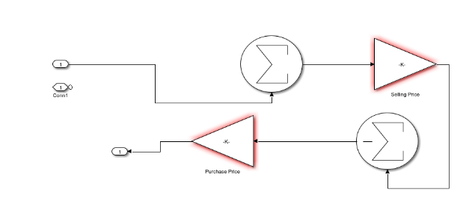
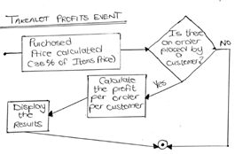
Simulation Model
Subsystems of the Takealot Inventory Simulation Model
PROFITS EVENT ALGORITHM
PROFIT CALCULATION SYSTEM
This subsystem calculates the profits generated by each warehouse for the three days of sales per customer sale
Notes:
The final subsystem is the profits event system. This subsystem would be used by the finance department of the company. This subsystem aims to provide the company with real time results to interpret how much profit the company would make per order placed by a customer on a particular day.
I was not able to obtain these values through the simulation, however I was able to obtain the profit values through excel formulations.

Slide 22
Conclusions and Future Recommendations
95%
Simulation needs to be improved to generate the expected outputs
The central warehouse generates has the most sales as it is closer to most customers and therefore generates the most profits
Benefit is that Takealot can deliver to any and every location increasing customer convenience an
Profit generation is a guarantee
Notes:
For this Takealot Inventory Problem, one discovery that was made is that the retail business is bound to make a profit on their items sold whether it is a large value or not.
The advantage the business has is that they are able to deliver to any and every location specified by the customer which increases the customer convenience and in turn boosts their sales daily.
Another discovery is that the central warehouse was able to generate more profits as more customers were buying from the Bloemfontein Warehouse due to the closest warehouse allocation done before the simulation started.
For the first recommendation, the Simulation needs to be improved to generate the expected outputs.

Slide 23
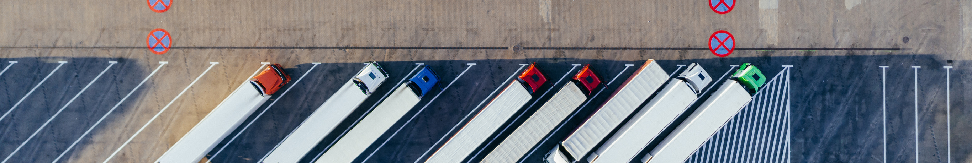
Future Improvements and Recommendations
*Automatically estimate distance difference in time between the customers location and the warehouse using a function
*Use a larger dataset to increase the accuracy of the results
*Create a function that would approximate when the parcel should be delivered
Notes:
*Automatically estimate the distance difference in time between the customers location and the warehouse using a function
*Use a larger dataset to increase the accuracy of the results
*Create a function that would approximate when the parcel should be delivered

Slide 24
References
REFERENCE 3
REFERENCE 1
Direct, B. (2015) The Barcode Blog. Available at: https://www.barcodedirect.com/the-evolution-of-inventory-management/ (Accessed: 27 September 2021).
Ahamed, S. (2020) Newspaper Sellers Problem, Inventory Management Syetem, Simulation and Modeling. Bangladesh: Youtube.com. Available at: https://www.youtube.com/watch?v=WfiuBSvxPCw.
REFERENCE 4
Google (2021) Google Maps. Available at: https://www.google.co.za/maps/@-34.6283864,27.2516951,5z (Accessed: 27 September 2021).
REFERENCE 2
Center, M. help (2021) Simulink. Available at: https://www.mathworks.com/help/simulink/index.html?s_tid=srchtitle_simulink_1 (Accessed: 27 September 2021).
REFERENCE 5
Grogan, P. (2016) Inventory System Discrete Event Simulation in Python (Event-scheduling). Youtube.com. Available at: https://www.youtube.com/watch?v=7LuN_6m7h2o&t=4s.

Slide 25
References
REFERENCE 6
REFERENCE 8
Sabila, A. D., Mustafid, M. and Suryono, S. (2018) ‘Inventory Control System by Using Vendor Managed Inventory (VMI)’, E3S Web of Conferences, 31, pp. 4–7. doi: 10.1051/e3sconf/20183111015.
Inc.com (2020) Inventory Control Systems. Available at: https://www.inc.com/encyclopedia/inventory-control-systems.html (Accessed: 27 September 2021).
REFERENCE 7
REFERENCE 9
ItsNowOrNever (2016) System Modeling and Simultion: Newspaper Seller’s Problem. India: Youtube.com. Available at: https://www.youtube.com/watch?v=OH8MRT8eqRI.
SubhashChandra Das, A. M. Z. (2020) ‘An application of preservation technology in inventory control system with price dependent demand and partial backlogging’, Alexandria Engineering Journal. Available at: https://www.sciencedirect.com/science/article/pii/S1110016820301058.

Slide 26
References
REFERENCE 10
REFERENCE 12
Takealot.com (no date) Robots.txt file. Available at: https://www.takealot.com/robots.txt (Accessed: 27 September 2021).
Takealot.com (2021a) More about our journey. Available at: https://www.takealot.com/about/our-journey (Accessed: 27 September 2021).
REFERENCE 13
REFERENCE 11
UpKeep (2021) What are the different types of inventory systems? Available at: https://www.onupkeep.com/answers/inventory-management/types-of-inventory-systems (Accessed: 27 September 2021).
Takealot.com (2021b) Takealot. Available at: https://www.takealot.com/ (Accessed: 27 September 2021).

Slide 27
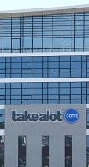


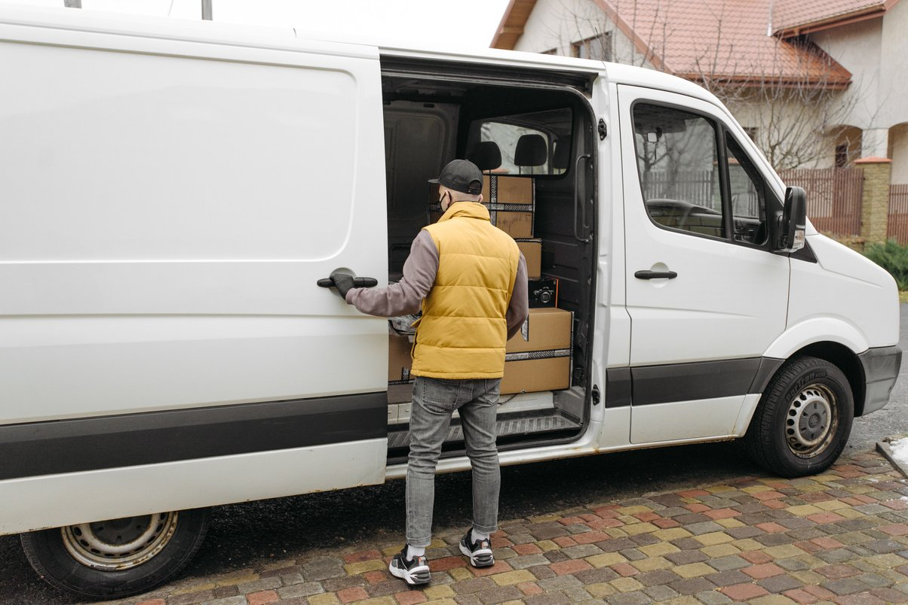
THANK
YOU
Any Questions?

